Slide 1







Learning Pulse
An AI-Agent-Driven Adaptive Teaching and Learning System
2026 PEAAII AI APPLICATIONS HACKATHON · UMASS BOSTON
A little insight. A better next step.
TEAM 3
Peter
Bucci
Ashriya
Tuladhar
Anya
Tongprasith
Drashti
Patel
Haniya
Adil
Swikritee
Chuke
Notes:
[0:00–0:20 · 20 seconds] Good afternoon. We’re Team 3: Peter, Ashriya, Anya, Drashti, Haniya and Swikritee, students here at UMass Boston. Our project is Learning Pulse. Our tagline is “a little insight, a better next step.” Learning Pulse connects AI-assisted student learning with the evidence teachers need to make better instructional decisions.

Slide 2



The Gap Between Student Understanding and Teacher Awareness
THE PROBLEM
Sam’s confusion stays hidden until the exam:
IN LECTURE
AT HOME
ON THE EXAM
Knows the vocabulary
Mixes up two ideas
Too late to help
Sam follows along and feels
confident.
Transmission delay and
propagation delay blur
together, and Sam doesn’t
notice.
The professor sees a wrong
answer and a grade, not the
reasoning behind it.
Students need help when confusion happens.
Teachers need to see that confusion before it becomes a grade.
02
Notes:
[0:20–1:00 · 40 seconds] Picture Sam, a student in an intro networking course. In lecture, Sam knows the vocabulary and feels confident. At home, Sam quietly mixes up two ideas, transmission delay and propagation delay, without noticing. The confusion only shows up on the exam, and by then the professor sees just a wrong answer and a grade. That grade doesn’t say what Sam misunderstood, whether Sam got help, or whether half the class had the same problem. Students need help when confusion happens. Teachers need to see it before it becomes a grade. (Note, not spoken: Sam is an illustrative student, not a real user.)

Slide 3














Today’s tools each see part of the picture
THE LANDSCAPE
DIRECT
DIRECT
INDIRECT
INDIRECT
AI tutors
Practice and
assessment
Learning
management
General AI
chatbots
Khanmigo
Wayground
Kahoot!
Canvas
Blackboard
ChatGPT
Claude
Guided tutoring and
lesson support
Engaging practice
and quizzes
Course materials
and grades
Quick explanations, not
tied to course materials
OUR
FOCUS
Student
reasoning
Evidence
Teacher
review
Approved
follow-up
New
work
03
Notes:
[1:00–1:30 · 30 seconds] Good tools already exist. Directly, Khanmigo offers AI tutoring and teacher support, and Wayground and Kahoot offer practice with reporting. Indirectly, Canvas, Blackboard and Google Classroom run the course, and students can always ask a general chatbot. We’re not claiming these tools lack AI or analytics. Our focus is narrower: one course-specific loop, from a student’s reasoning, to evidence, to the teacher’s review, to an approved follow-up, and back to new work.

Slide 4









Empowering Educators and Students at Scale
TARGET USERS & IMPACT
PRIMARY
University instructors
SCALE CONTEXT
Spot misunderstandings early and spend
class time where it matters.
16.2M
SECONDARY
Undergraduate students
Guided explanations, questions and
feedback outside class.
U.S. undergraduate enrollments
in fall 2025
POTENTIAL ADOPTERS
Departments and universities
Source: National Student Clearinghouse
Research Center, January 2026.
Including teaching and learning centers.
STARTING WITH STEM COURSES
Networking:
our first lesson
Computer
science
Engineering
Mathematics
Physics
04
Notes:
[1:30–1:55 · 25 seconds] Our primary users are university instructors who want to catch misunderstandings early. Students like Sam get guided help outside class, and departments and teaching centers could adopt it more broadly. We’re starting with concept-heavy intro courses, beginning with a networking lesson here at UMass Boston. For scale, about 16.2 million undergraduates enrolled in the U.S. last fall. That’s context, not a market claim.

Slide 5



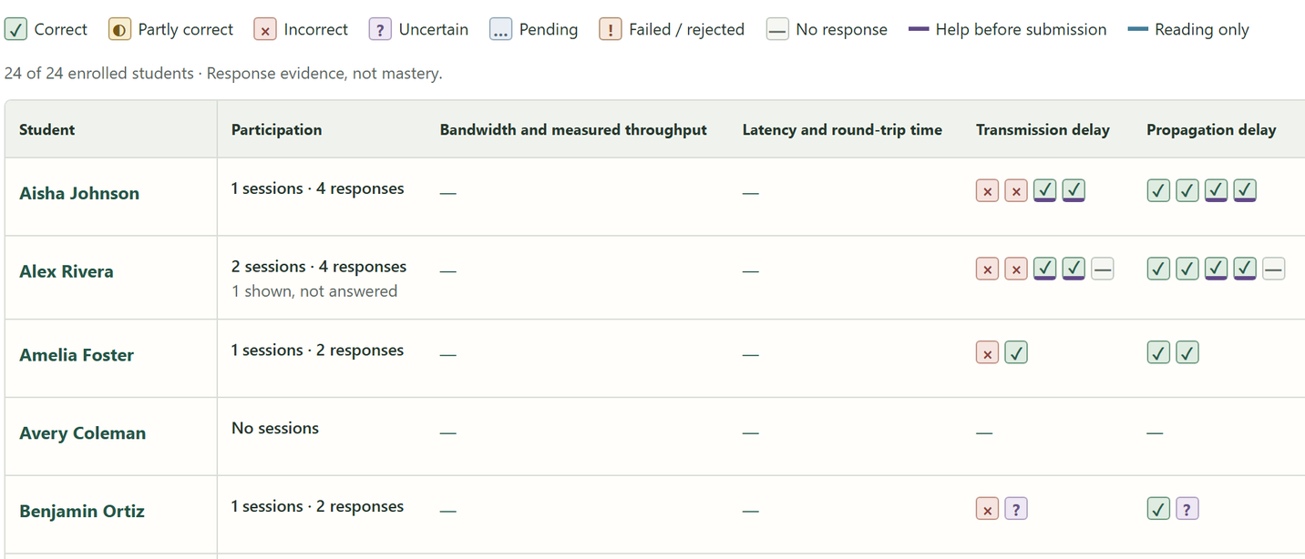













Learning Pulse connects both sides of learning
HOW IT WORKS
1
TEACHER
2
STUDENT
3
TEACHER
Prepares
Learns
Investigates
AI proposes material; the
teacher approves it.
Every answer and every hint
shown is recorded.
Reviews the evidence and
approves a follow-up.
Course materials
AI generates (editable)
Approved
lesson
I’m confused about what transmission
delay actually means.
Learning
evidence
Class evidence by idea
Syllabus
Learning objectives
Practice questions
It can help to separate sending the bits from the bits travelling along the link.
Lecture slides
Readings
Explanations & hints
AI-drafted follow-up
Other resources
Teacher approves
Student
responses
Hints
shown
Time spent
& attempts
Choose the answers to use
Save a private draft
Approve
Choose the students
The approved follow-up becomes new student work
05
Notes:
[1:55–2:25 · 30 seconds] Here’s the whole idea on one slide. First, the teacher prepares a lesson. AI can propose material, but the teacher approves it. Second, the student works through it with an AI tutor, and the system records what the student actually wrote and what help they actually saw. Third, the teacher investigates that evidence and approves a targeted follow-up, which becomes new student work. Then the loop continues. Let’s follow Sam through each step.

Slide 6
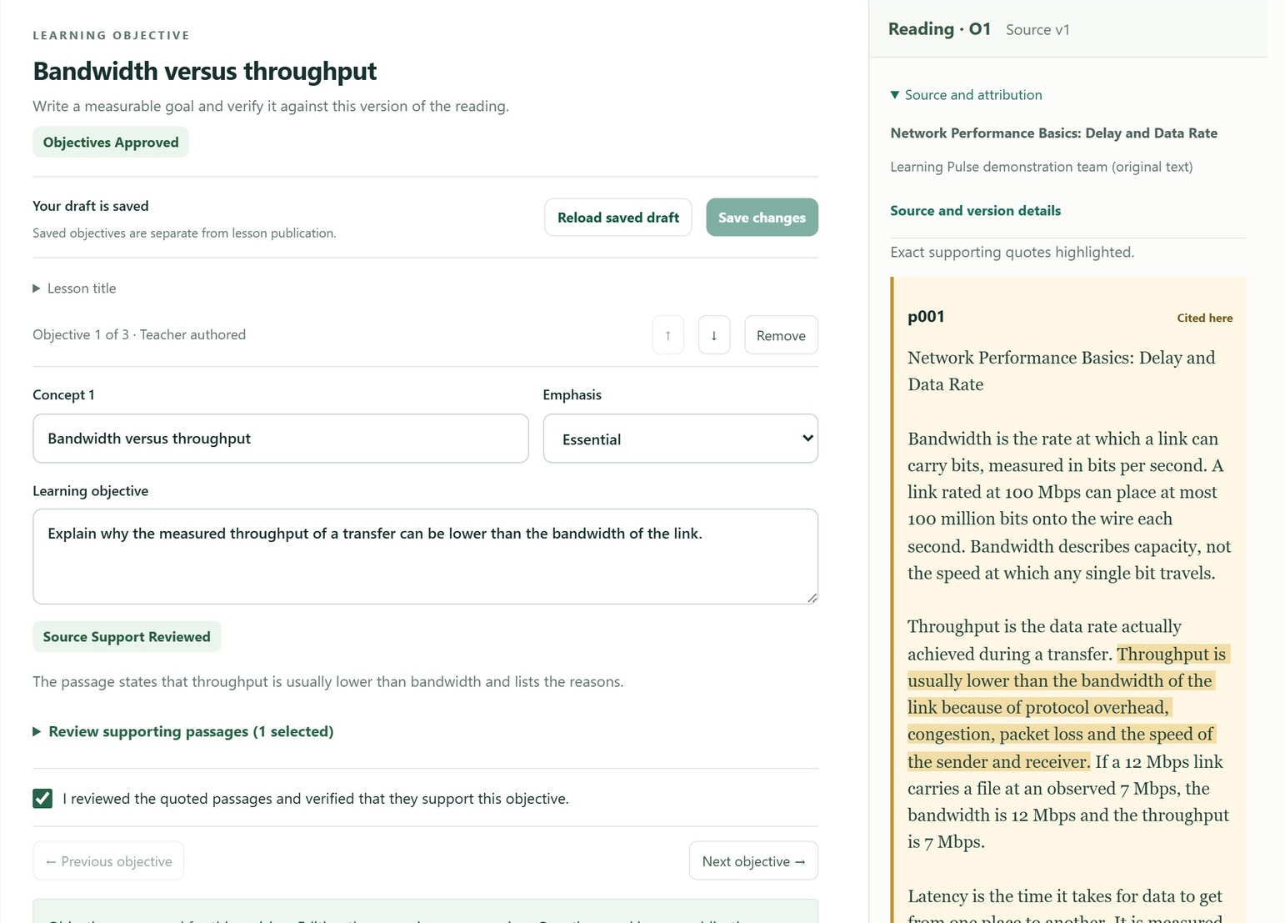






The teacher sets the source of truth
STEP 1 · TEACHER PREPARES
AI proposes. The teacher approves.
Bring in course material
Upload lecture slides, readings or notes.
Learning Pulse organizes them into
citable source passages.
Review what AI suggests
AI drafts learning objectives and
practice questions, all editable by
the teacher.
Publish a fixed lesson version
Students get the approved lesson,
and every answer stays tied to it.
Course material
(teacher upload)
AI proposes
(teacher reviews)
Approved lesson
(for students)
06
Notes:
[2:25–2:50 · 25 seconds] Step one is the teacher. An instructor brings in course material; for our demo, an openly licensed networking textbook section. Learning Pulse organizes it into source passages, and AI can propose objectives and questions. The teacher edits them and publishes a fixed lesson version. AI proposes; the teacher approves. And as you see on the right, every answer stays tied to that exact version and passage.

Slide 7



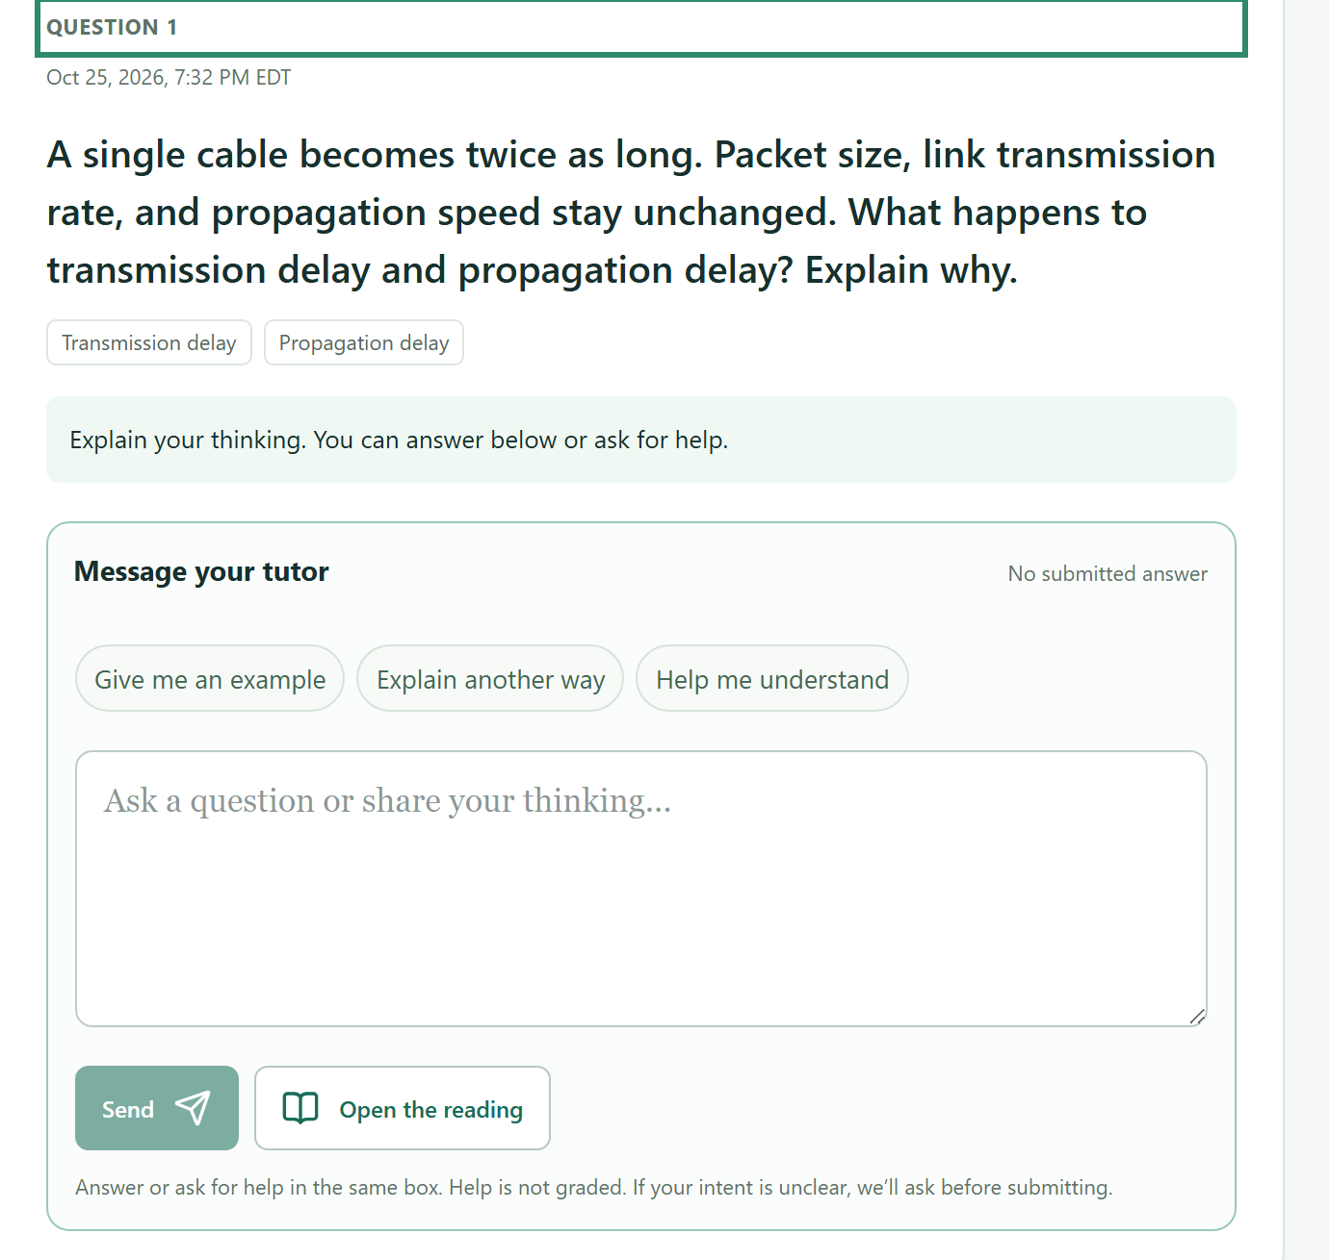
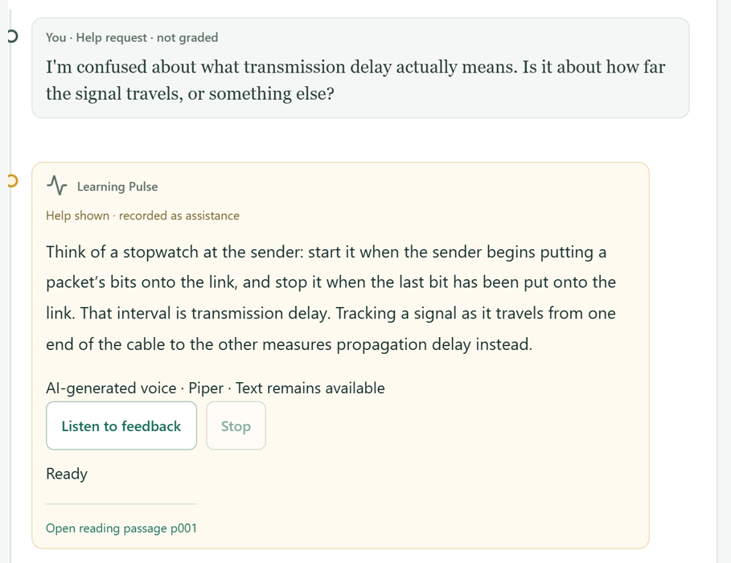


Sam works through the question with a tutor
STEP 2 · STUDENT LEARNS
An AI tutor guides Sam with hints, not answers, and records the learning process.
STUDENT VIEW
RECORDED FOR THE TEACHER
Ask or answer
The tutor tells a help request from
an answer, and asks if it’s unclear.
Hints, not answers
It separates the two ideas and
points Sam back to the reading.
Saved evidence
Everything is saved
Student’s original answer
Sam’s own words and the help
actually shown are recorded
as evidence.
Help request and tutor response
Hints shown and reading references
The tutor gives hints and guidance
based on Sam’s answer.
All interactions are recorded
as learning evidence.
07
Notes:
[2:50–3:30 · 40 seconds] Step two: Sam opens the assignment. If a cable becomes twice as long, what happens to transmission and propagation delay? Sam can answer or ask for help in the same box. The system tells a help request from an answer, and if it’s unclear, it asks before grading. Here, Sam asks for help. Instead of giving the answer away, the tutor separates the two ideas and points Sam back to the assigned reading. Learning Pulse records what Sam wrote and what help was actually shown. These screens are from our test environment.

Slide 8















Inside the tutor: propose, check, act, record
UNDER THE HOOD · AGENTIC WORKFLOW
A bounded, evidence-grounded workflow that turns student questions into guided learning.
01
STUDENT INPUT
02
AI PROPOSES
03
SERVER CHECKS
04
TOOL RUNS
05
RESULT RECORDED
Ask a question
Pick an action
Verify and ground
Execute the action
Save as evidence
A question, an answer or
a request for help.
The tutor chooses an
instructional action.
Access, lesson version and
sources are validated.
Only authorized tools
execute.
The interaction and sources
are saved for review.
I’m confused about
transmission delay vs.
propagation delay.
Can you explain?
Explain or give a hint
Authorization check
Content retrieval
Saved to learning history
Original answer
Ask a diagnostic question
Lesson version check
Tutoring (explanation)
Help shown
Evaluate an answer
Source check
Diagnostic question
Sources used
Evaluation
The tutor observes each result and chooses its next step
AUTHORIZED
TOOLS
Content retrieval
Tutoring
Evaluation
Evidence recording
Intervention drafts
Approved passages from
the lesson version
Explanations, hints and
clarifying questions
Assesses submitted
reasoning
Saves work, help shown
and sources
Follow-ups the teacher
approves
08
Notes:
[3:30–4:15 · 45 seconds] For the technical judges, here’s the agentic part in plain terms. When Sam sends a message, the AI doesn’t act on its own. It proposes an instructional action, like retrieving a passage or evaluating an answer. Our server checks that proposal: is this student allowed, is this the right lesson version, is the source approved? Only then does an authorized tool run. The result is recorded as evidence, and the tutor observes it to choose the next step. So it’s one tutor with a bounded set of tools, not a team of autonomous agents, with structured outputs and Zod schemas validating each step.

Slide 9


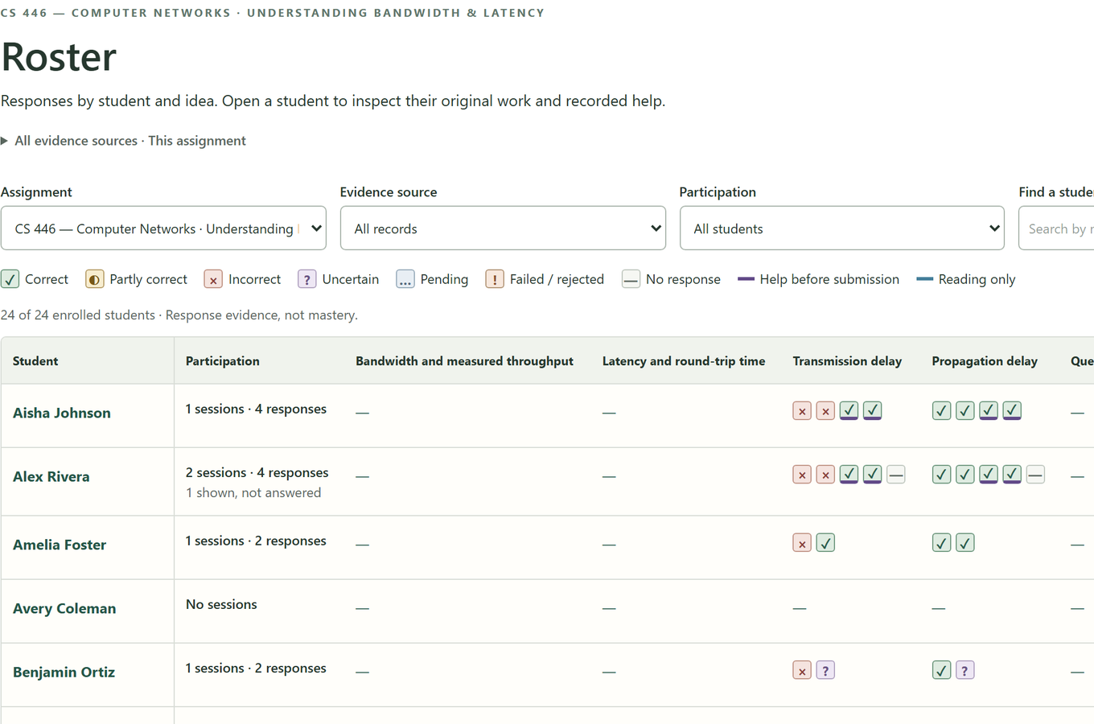
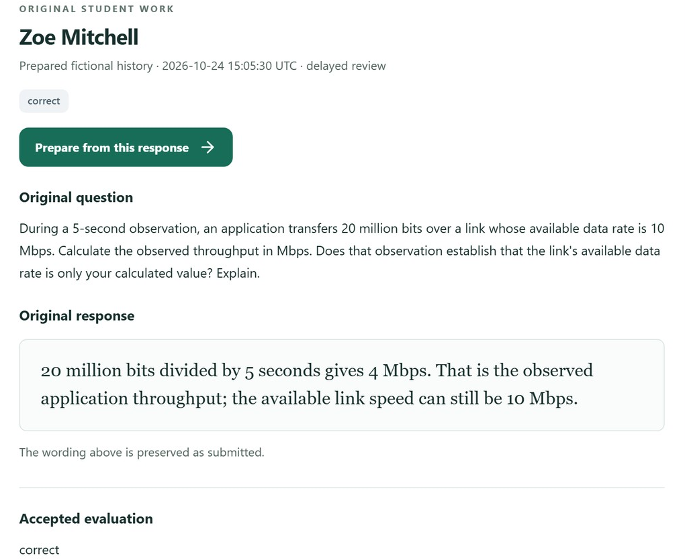
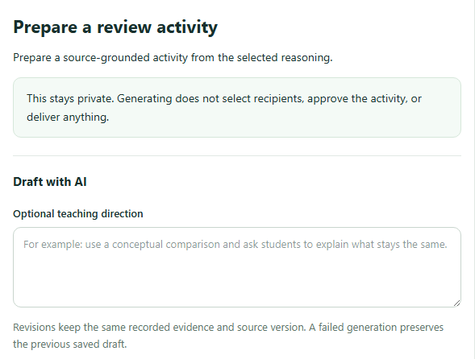


The professor sees how students reasoned
STEP 3 · TEACHER INVESTIGATES AND RESPONDS
From class-wide insights to targeted follow-ups, with full context and AI support.
See the class
Read the reasoning
Prepare a follow-up
Spot patterns across every student
and every idea.
See the original question and the
student’s own words.
Use AI to draft targeted practice,
then review it.
Every student’s attempts on every idea,
including answers given after help.
The original words, preserved as
submitted, with the accepted evaluation.
AI helps draft practice. Students see it
only after the teacher approves.
KEY TEACHER VALUE
Full visibility into student thinking
Spot possible misconceptions early
Turn insights into targeted follow-ups
09
Notes:
[4:15–4:55 · 40 seconds] Step three: the professor. Instead of one percentage, the class grid shows every student’s attempts on each idea, and flags answers given after help. Here, one fictional student has a long run of mixed attempts on transmission delay, the kind of pattern Sam would leave. Select a cell to read the student’s original words and the accepted evaluation. Uncertain evidence isn’t treated as wrong, and a possible misconception isn’t presented as fact. From any response, the professor can prepare a follow-up, and as these steps show, nothing reaches students until the professor approves it.

Slide 10


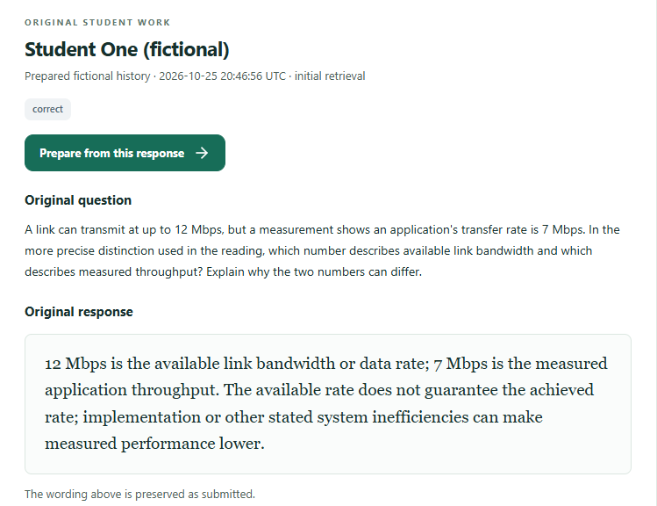






From answering questions to improving instruction
WHAT MAKES IT DIFFERENT
We go beyond correctness, connecting student reasoning, trusted course material and teacher decisions.
1
Reasoning, not just
correctness
2
Grounded in approved
material
3
AI closes the loop,
people decide
We keep students’ original thinking
next to the evaluation, so teachers
can see what happened.
The tutor works from the instructor’s
lesson version, and old work keeps
its original source.
Student work informs teaching, and
instructors approve every official
instructional action.
Approved source
Teacher approved
From insights to action
Peterson & Davie, Computer Networks §1.5.1 · CC BY 4.0
Spot possible misconceptions
Source passages
P01 · source passage
Backed by supporting and contrary evidence
P05 · Link and channel
bandwidth
Network performance is measured in two fundamental ways: bandwidth (also called throughput) and latency (also called delay)…
Draft targeted practice
AI drafts a private review activity
P07 · Propagation,
transmission and queuing
Teacher review and approval
P08 · Delay equations
and definitions
Choose what to assign to students
Deliver and read follow-ups
P12 · Latency terminology
in context
Later work links back to the intervention
Reveals how students think, not just
whether they’re right or wrong.
Keeps every explanation traceable
to approved course material.
Turns individual reasoning into
targeted, teacher-approved practice.
The cycle repeats with each new round of student work.
10
Notes:
[4:55–5:25 · 30 seconds] So what sets Learning Pulse apart? First, we capture reasoning, not just correctness: answers, help received and evaluations stay together. Second, learning stays grounded in instructor-approved material, and old work keeps its original source. Third, AI helps close the loop, but people decide: instructors approve every official action. These describe our focus, not claims that other tools can’t do any of this.

Slide 11



Built for responsible and trustworthy use
RESPONSIBLE AI
We design with guardrails, test our engineering, and are transparent about what’s next.
Built-in safeguards
Thoroughly tested
Transparent about limits
The server checks every AI
action before it runs.
Automated checks of behavior
and data integrity.
We are honest about what
isn’t yet shown.
Only authorized tools can be executed.
Deterministic unit and TypeScript tests.
Measured improvement in learning outcomes.
Teachers approve interventions before students see them.
Signed-in browser workflows with fictional students.
A production deployment and compliance review.
Uncertain evidence is never scored as wrong.
Database persistence and save-recovery checks.
Full accessibility and device testing.
AI supports instructional decisions. It doesn’t replace educator judgment.
11
Notes:
[5:25–6:05 · 40 seconds] Because this is an agentic AI project, responsibility matters. Every AI action passes server checks before it runs. Teachers approve interventions before students see them, and uncertain evidence is never scored as wrong. We’ve tested this with unit tests, signed-in browser workflows using fictional students, and database and recovery checks. But those are engineering checks. We haven’t measured learning outcomes, this isn’t a production deployment, and accessibility and device testing are still in progress. Our principle: AI supports instructional decisions; it doesn’t replace educator judgment.

Slide 12



From one lesson to a whole course
FUTURE VISION
NEAR TERM
MEDIUM TERM
LONG TERM
Prove it in classrooms
Broaden and connect
A learning
intelligence layer
Finish cross-role testing,
validate the tutor with real
models and pilot with
instructors and students.
More subjects, richer
learning histories, visual
explanations and Canvas
integration.
Help educators understand
how students reason across
an entire course.
12
Notes:
[6:05–6:30 · 25 seconds] Near term, we want to prove this in real classrooms: finish cross-role testing, validate the tutor with real models, and pilot with instructors and students. Then we’ll broaden to more subjects and connect with Canvas. Long term, Learning Pulse could become a learning intelligence layer for a whole course. Licensing is a possible model, but it isn’t validated yet.

Slide 13
Learning Pulse
—— Every learning insight drives a better teaching decision.
THANK YOU！
Q & A
Notes:
[6:30–6:45 · 15 seconds] So the next time Sam mixes up two ideas, the professor can see it and help before it becomes a grade. Learning Pulse turns student reasoning into better-informed teaching decisions. Thank you. We’d love to take your questions.

Slide 14
References
APPENDIX
Learning Pulse repository
github.com/peterbucci/ai-teaching-platform
BUILT WITH
National Student Clearinghouse Research Center, Final Fall Enrollment Trends (January 2026)
Frontend · Next.js, React, TypeScript, Tailwind CSS
nscresearchcenter.org/final-fall-enrollment-trends
Canvas by Instructure
Backend and data · Next.js server endpoints, Node.js, PostgreSQL, Docker Compose, Better Auth
instructure.com/canvas
Khanmigo, Khan Academy
khanmigo.ai
AI and evaluation · OpenAI API, structured outputs, source-grounded retrieval, server-side action validation, Zod schemas
Wayground, Reports on Wayground
help.wayground.com/support/solutions/articles/158000404058
Peterson and Davie, Computer Networks: A Systems Approach, §1.5.1 “Bandwidth and Latency,” CC BY 4.0
Quality · GitHub Actions, TypeScript and deterministic tests, browser integration tests, authentication, data-integrity and recovery tests
github.com/SystemsApproach/book · creativecommons.org/licenses/by/4.0
14
Notes:
Appendix slide for reference during Q&A; not presented in the 7-minute talk.

